Slide 1
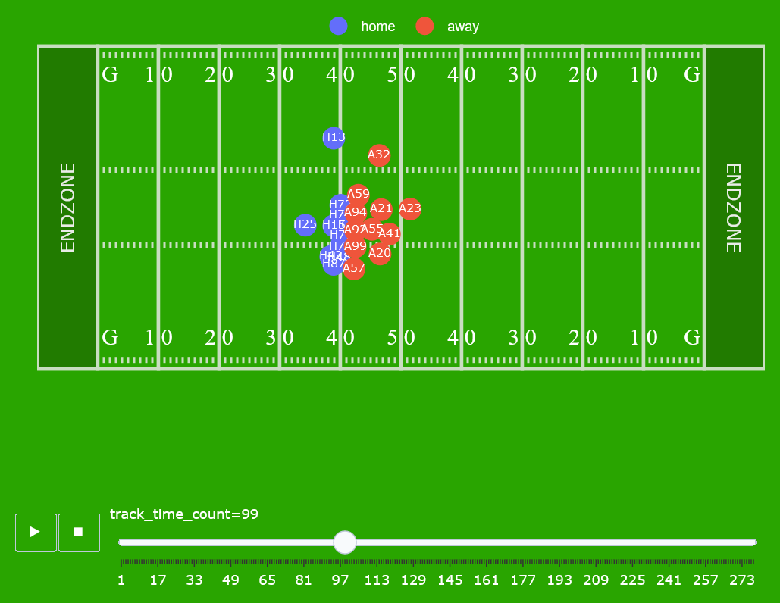
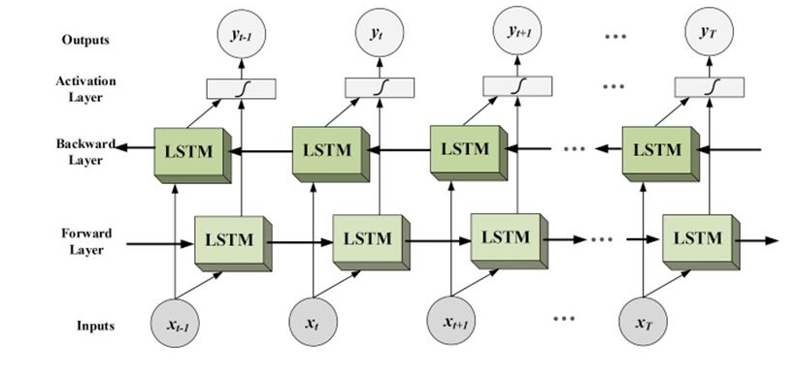
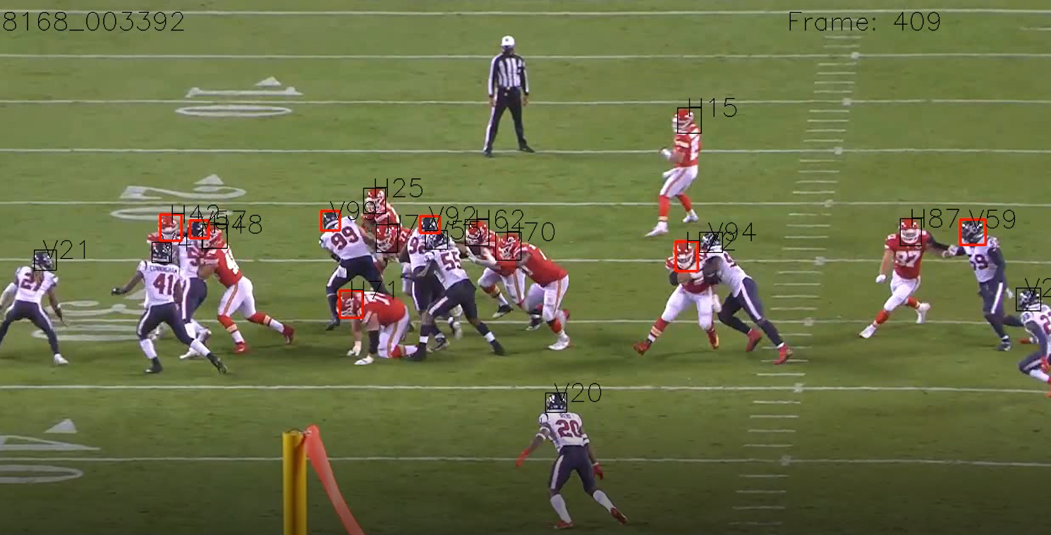
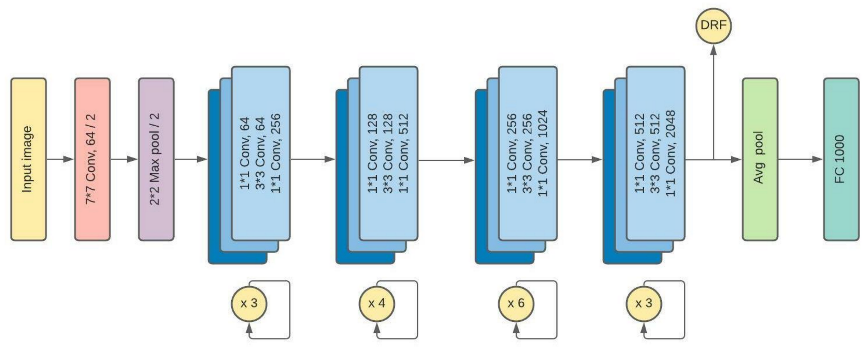
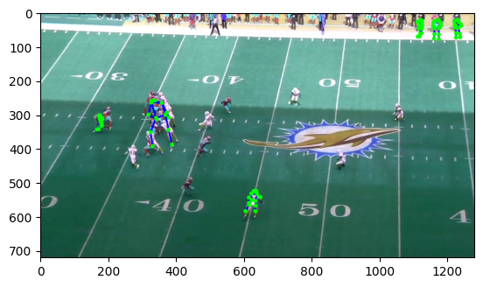
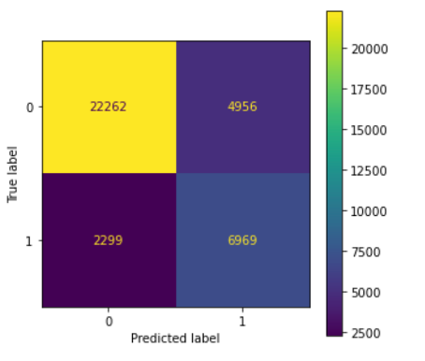
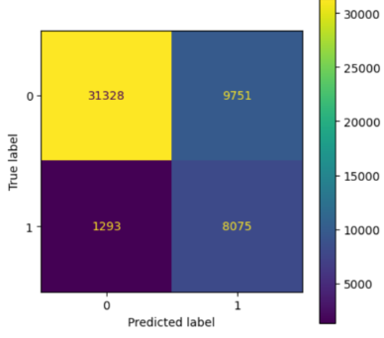
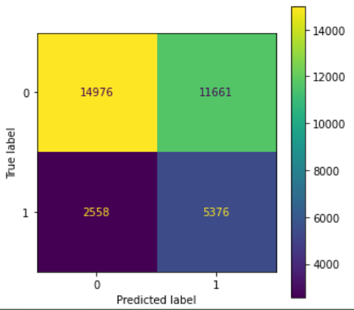
Players Contact Detection - Israel Tech Challenge Project
Kevin Benhamou, Oleg Podlipalin, Ariel Cohen,
Introduction
Visualization
Models
The project named Player Contact Detection. The goal of the project is to detect and predict moments of contact between American football player pairs from Sensor and Video Data. Each play has four associated videos.
Business usage:
Injury prevention and management
Performance analysis
Player scouting and recruitment
Sports betting
Bidirectional LSTM
ResNet50 Model
Data
Each play has four associated videos. Two videos, showing a sideline and endzone view, are time synced and aligned with each other.
Datasets of corresponding labels of each players, tracking players in the ground, and the helmets position.
Results
XGBOOST
LSTM
ResNet50
General Strategy
Work with ML models (RF, XGB)
Work with DL models (LSTM, CNN)
IoU = 0.49
IoU = 0.42
IoU = 0.27

